Slide 1


Sales Insights - Data Analysis Project using Tableau

Slide 2
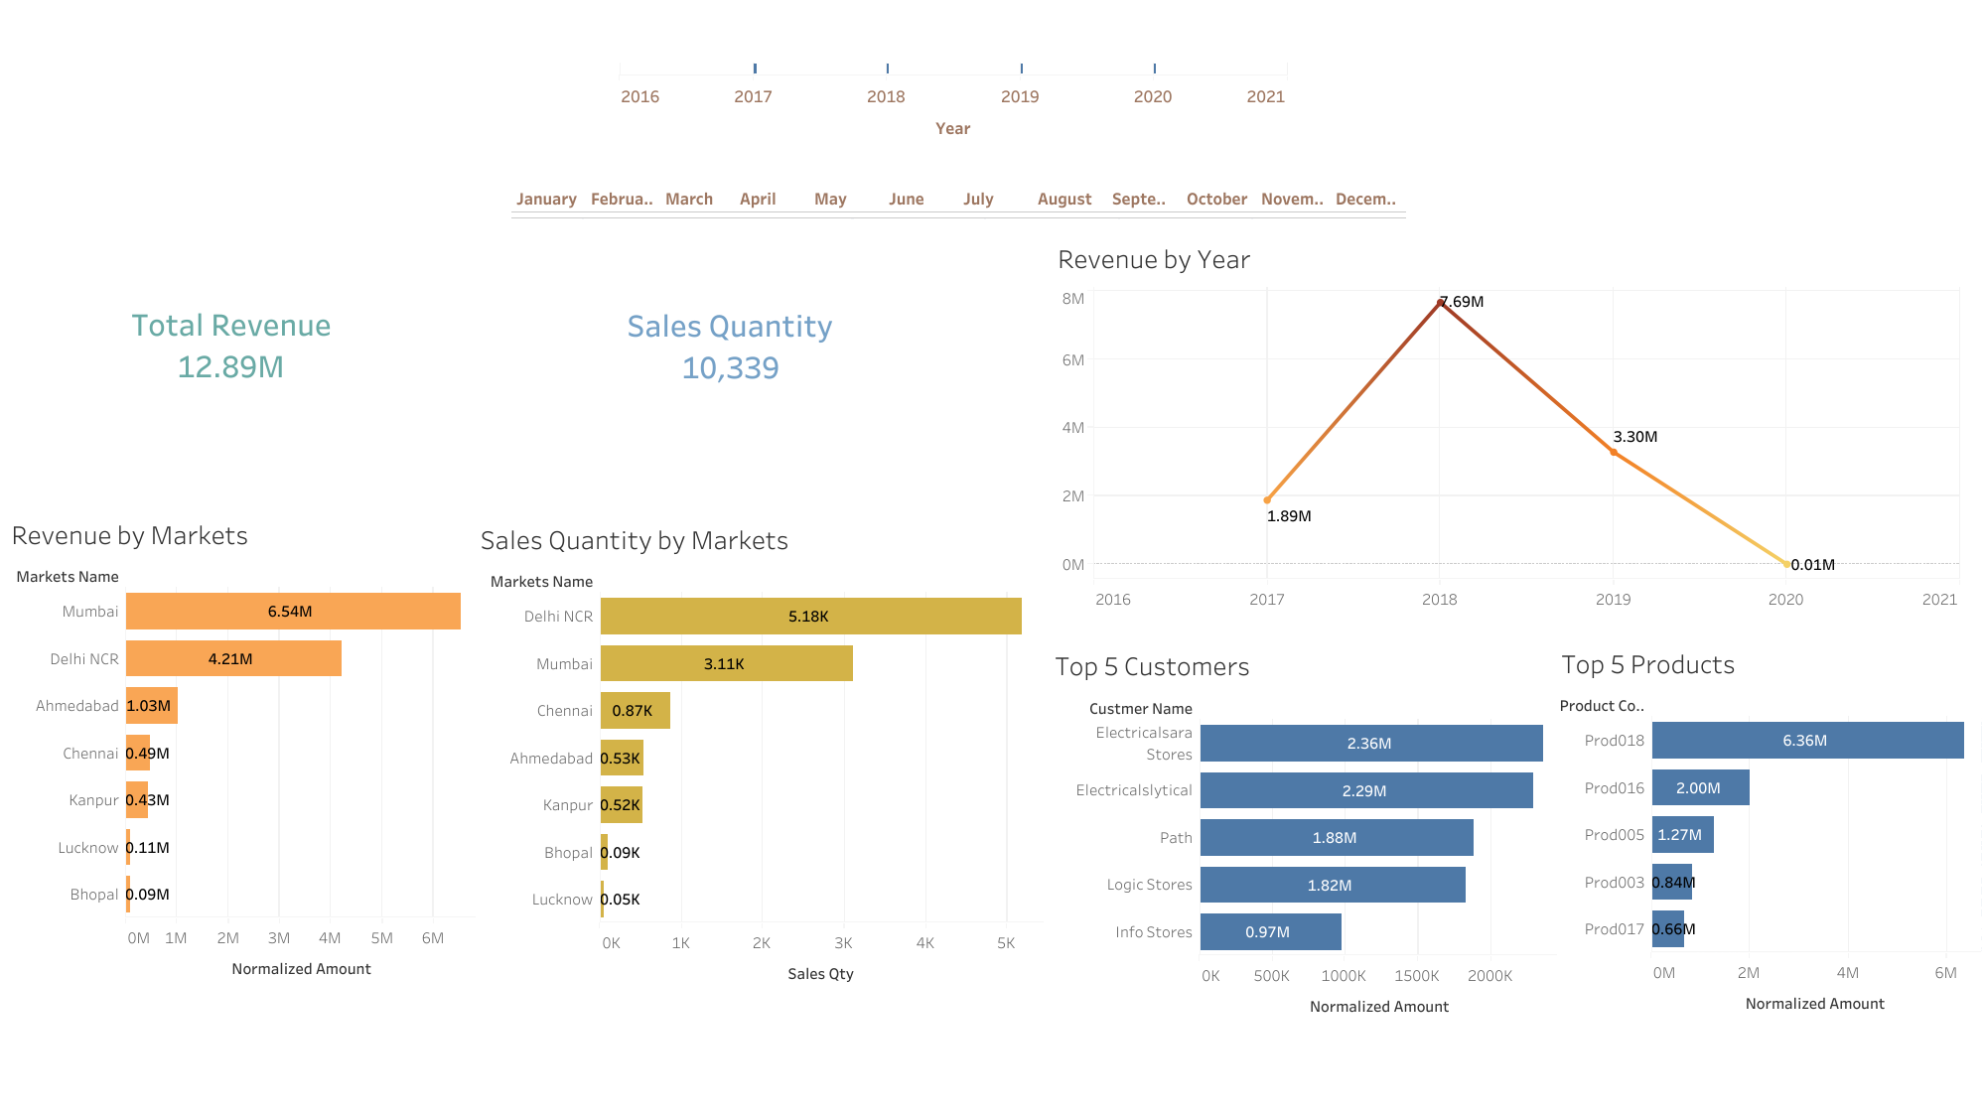

Slide 3
